Slide 1
Nsure Motor Policy Issuance System
Members
MohanaKrishnan S
Jeya Sundari G
Akshaya M
Jose Antony Muthu S
Guided By
Industry mentor : Mrs. Yukthika
Faculty mentor : Mr. Nanda kumar
Department of CSE, KGiSL Institute of Technology, Coimbatore

Slide 2
Abstract
Insurance is a means of risk management process primarily allows individuals, businesses and other entities to protect themselves against significant potential losses and financial hardship at a reasonably affordable rate.
NSure Insurance project is going to be a product – oriented software solution covering every business area in Insurance and has to provide the statistics defined in Client’s SRS for Motor Insurance processes.
Department of CSE, KGiSL Institute of Technology, Coimbatore

Slide 3
Area Introduction-Existing system
The existing system contains modules like cover note & quotation issuance, underwriting, renewal & endorsement.
The existing system calculates the loading amount using common Motor Tariffication principles with Underwriting rules.
The existing system has fewer options for users types such as admin & agent and has limited options for agent users.
Department of CSE, KGiSL Institute of Technology, Coimbatore

Slide 4
Proposed System
Proposed System is to implement latest technology for making the system still more beneficial to cover the core areas like integrated client information for
1.Motor & Non Motor clients ( for Personal Accident Policy)
2.Policy & Underwriting Administration
3.Endorsement features
4.Renewal alerts
Advantages over existing methods
The system is planned to be built using Java technology (Angular JS 4 & Spring), Jasper Reports and Oracle as database, the system to be developed has to integrate with ongoing maintenance changes without modifying business data and should also minimize the risks.
Future Enhancements
1. Enhanced features in Agent portal with renewal alerts and endorsement options based on Motor detariffication process.
2. To implement Chatbot features in Direct Sales & Agent portal.
3. More features in Rule Engine for setting up business/government rules
Department of CSE, KGiSL Institute of Technology, Coimbatore

Slide 5
Literature Review
Drawbacks of existing methods
Implementing Motor detariffication process in :
Web services
Direct Sales portal
Agent portal
Motor De-Tariffication – Is liberalisation of Motor Insurance Tariff (introduced during July 2017).
References
www.insurance.com.my
www.tutorialspoint.com › Java
Department of CSE, KGiSL Institute of Technology, Coimbatore

Slide 6
Module Split-up
Module 1:
Quotation
New Business
Master & Fleet Policy Creation
Module 2:
Covernote Options
Renewal
Road Tax Purpose
Transfer of Ownership
Module 3:
Endorsement
Module 4:
Enquiry and Reporting
Department of CSE, KGiSL Institute of Technology, Coimbatore

Slide 7
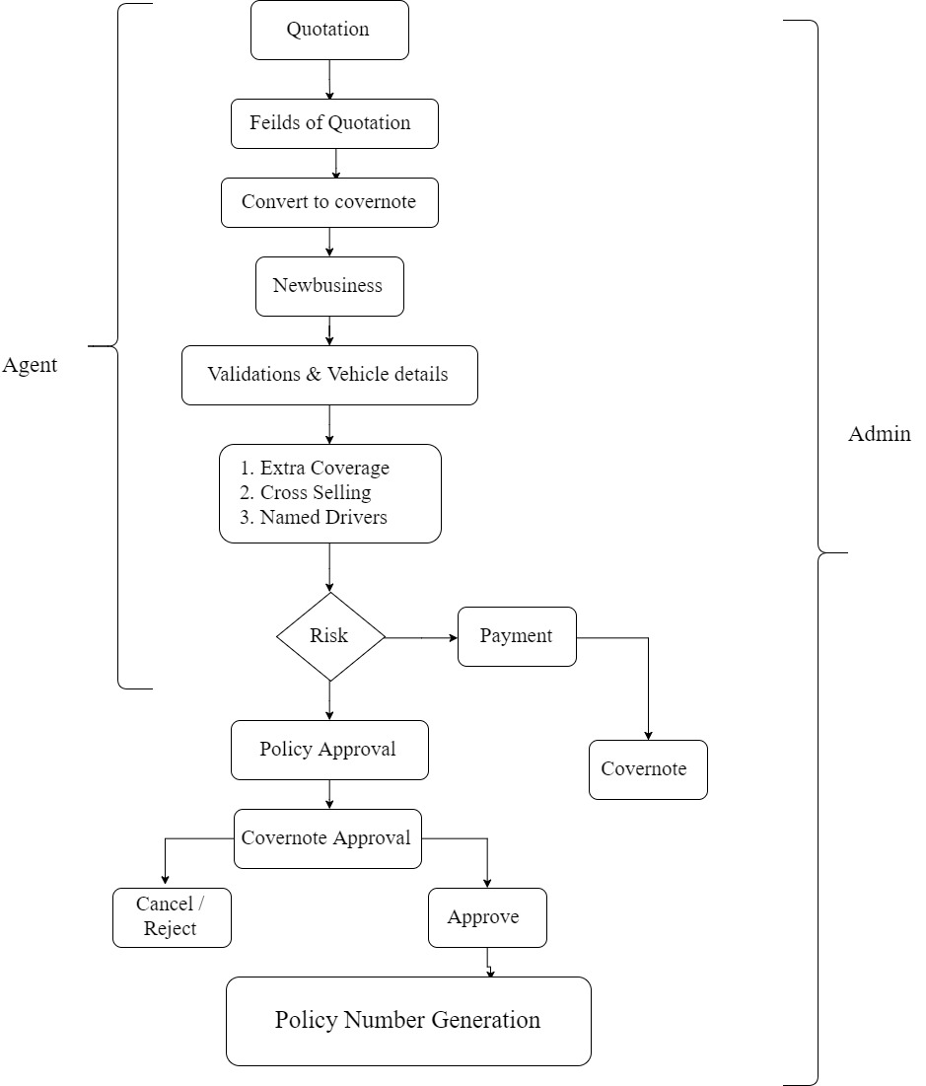
Architectural Design

Slide 8
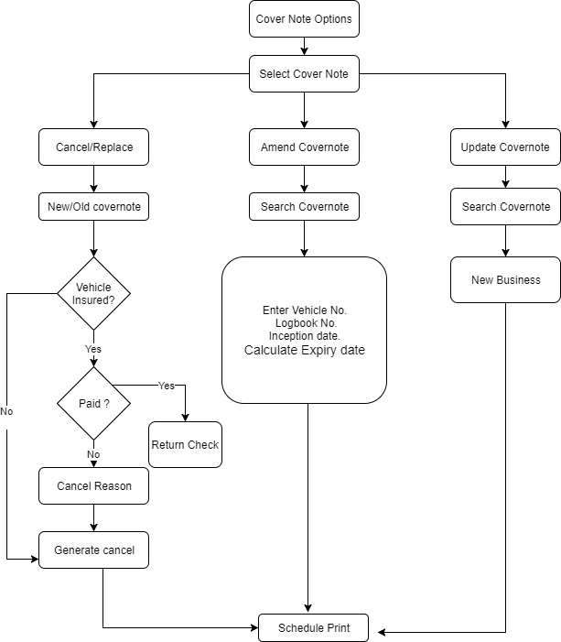
Architectural Design

Slide 9
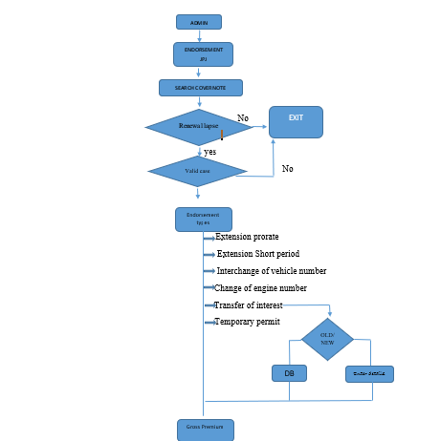
Architectural Design

Slide 10
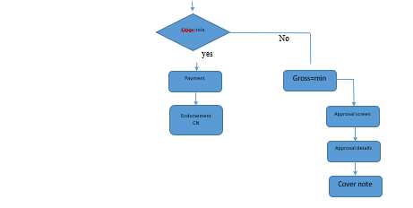
Architectural Design

Slide 11
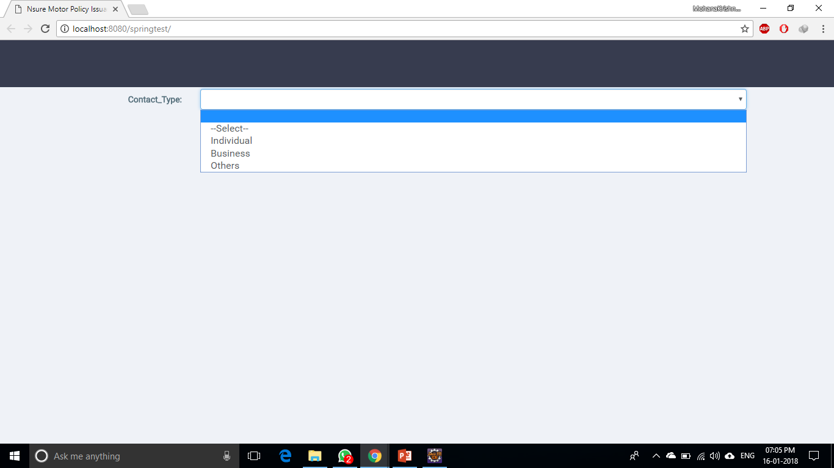
Screen shots of modules under progress.

Slide 12
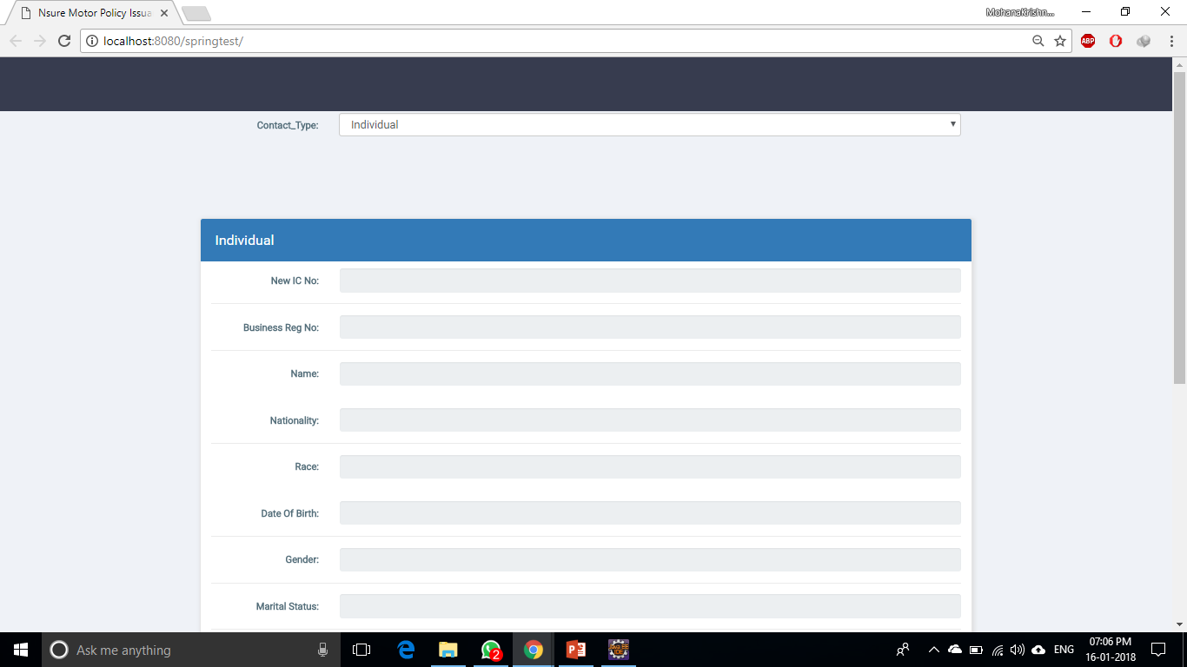
Cntd...

Slide 13
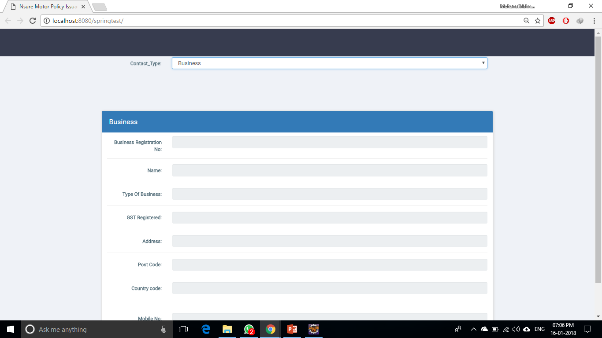
Cntd...

Slide 14
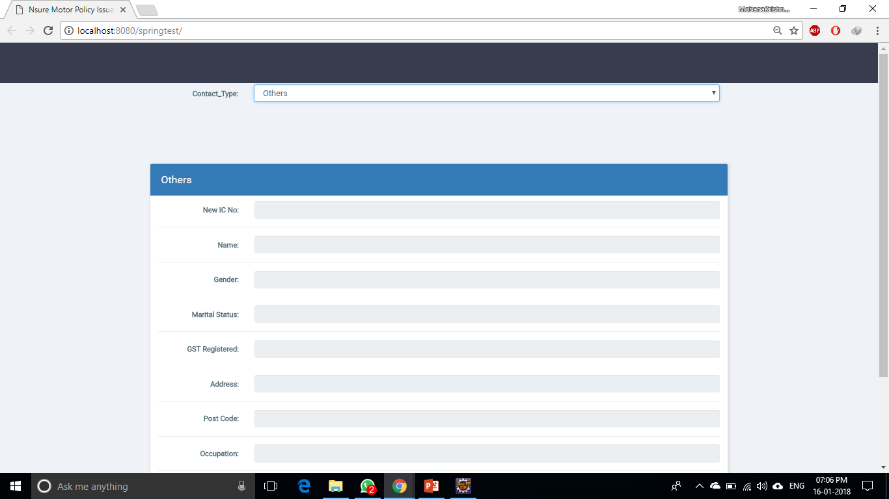
Cntd...

Slide 15
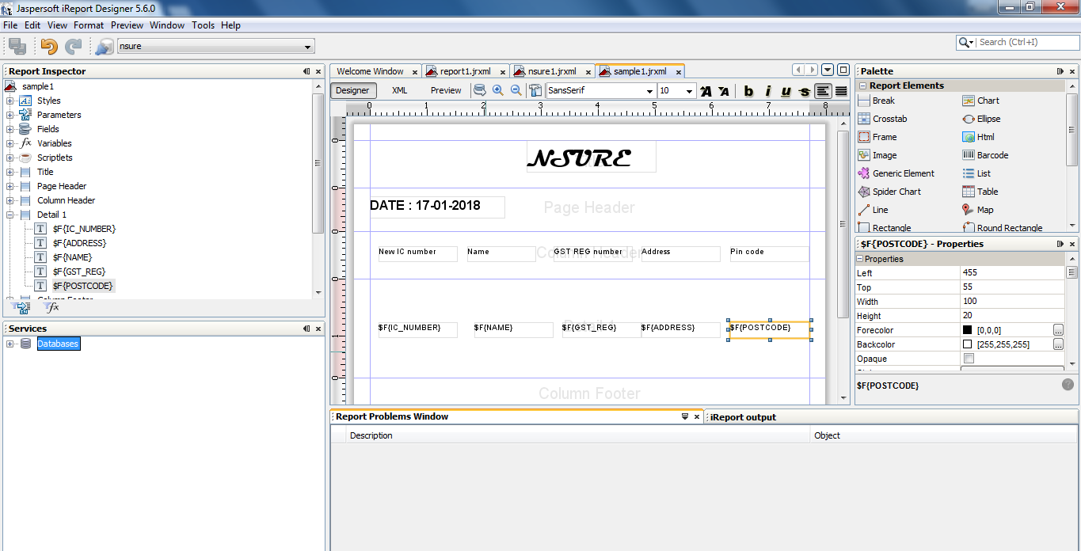
Cntd...

Slide 16
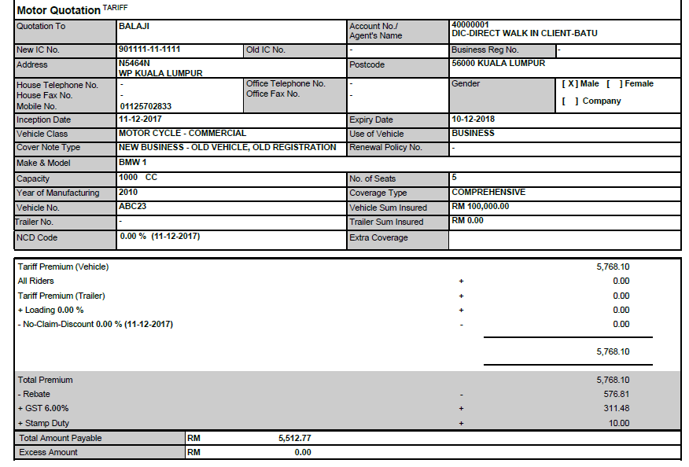
Cntd...

Slide 17
Thank You

